Slide 1
CMSC 635 : DISCOVERY KNOWLEGDE & DATA MINING
BRIEF GUIDE FOR USING WEKA SOFTWARE

Slide 2
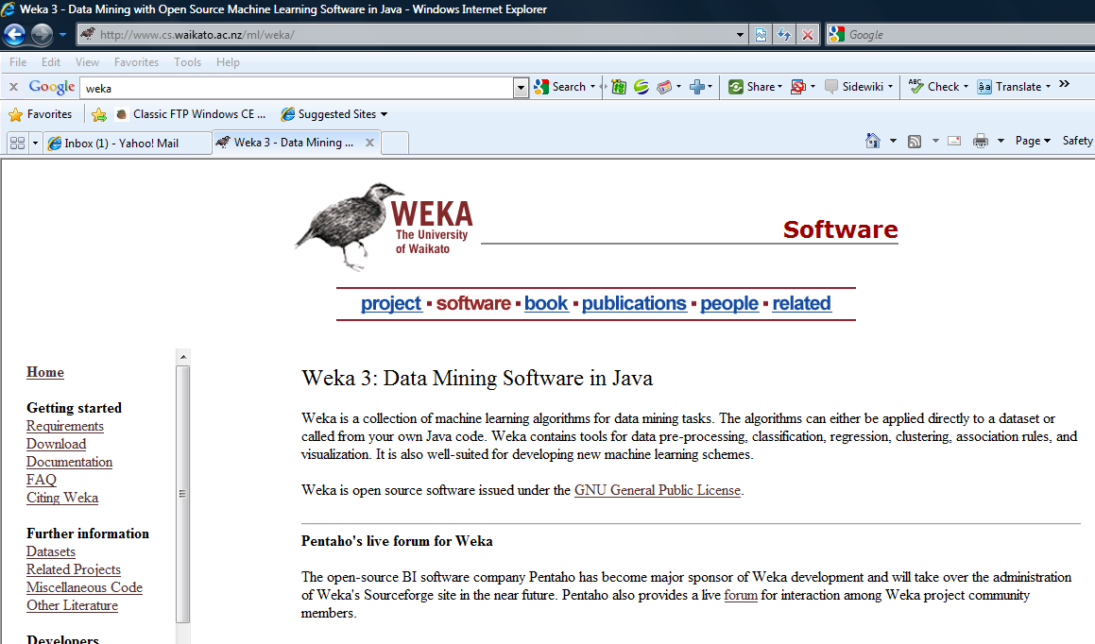
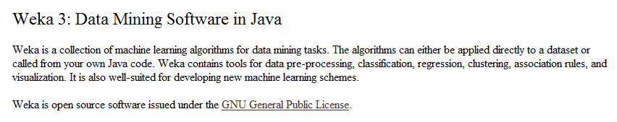
WEKA : Open Source Software for DataMining
Official website:
http://www.cs.waikato.ac.nz/ml/weka/
Attention: Have to install Java Runtime Environment before

Slide 3
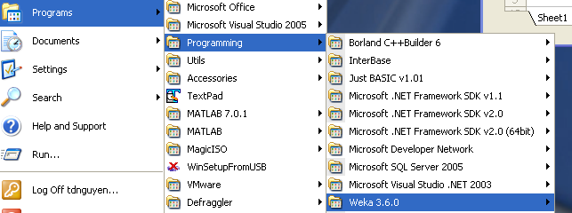
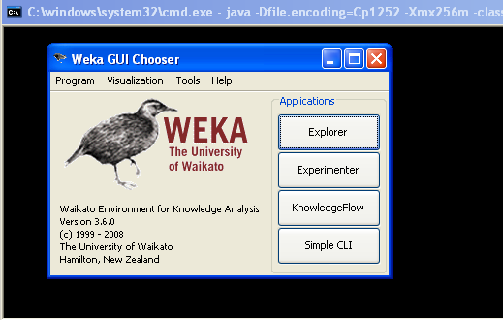
Running WEKA software (after installed)
Click button Explorer

Slide 4
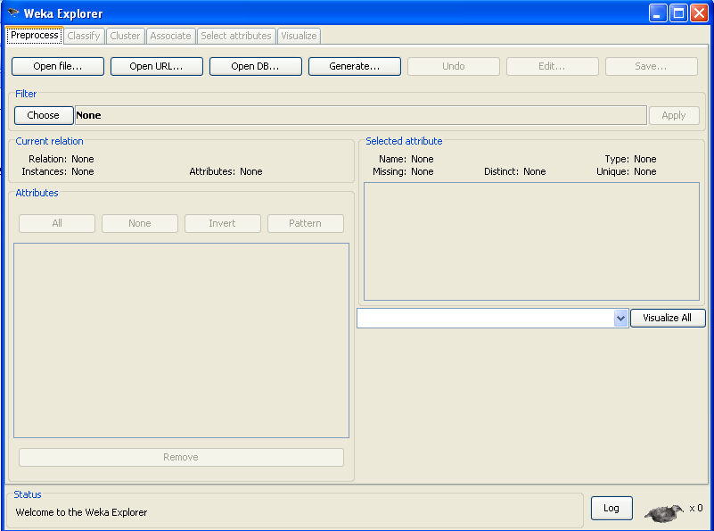
WEKA ‘s windows
Click here to open dataset file (.arff)

Slide 5
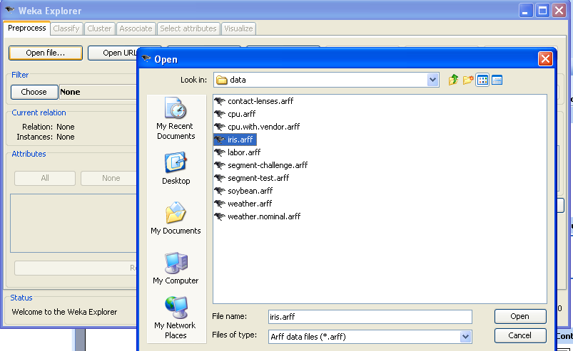
Select data file

Slide 6
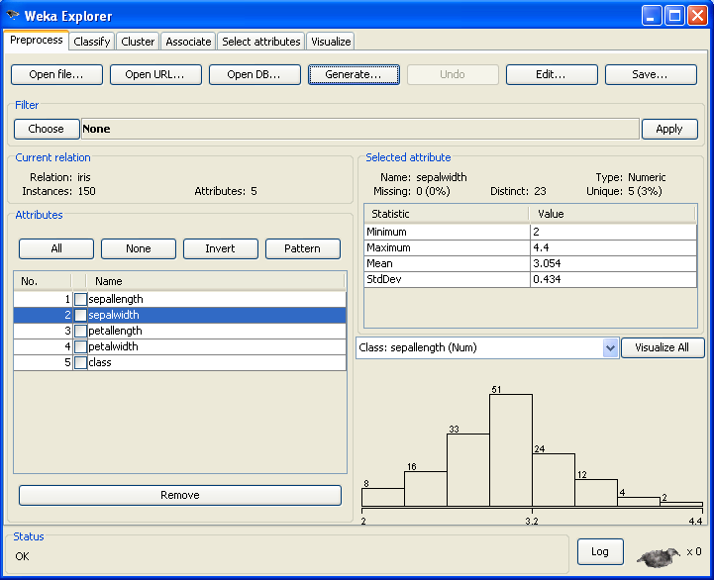
Dataset’s information
Features,
Instances,.
Feature’s
informations
Attributes’s list
Delete chosen features

Slide 7
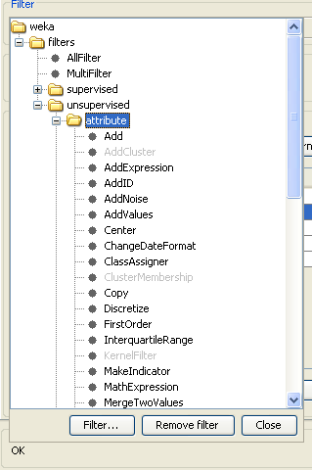
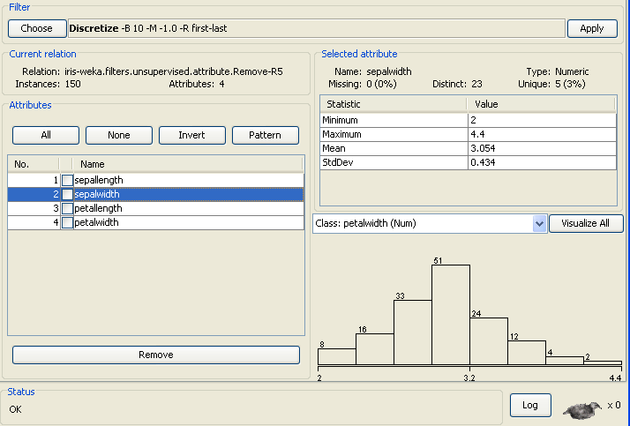
Tab Preprocess : Click button Choose…
And choose wanted task. For example : Discretize

Slide 8
After choosing any task, click here to customize parameters
Click here !!!

Slide 9
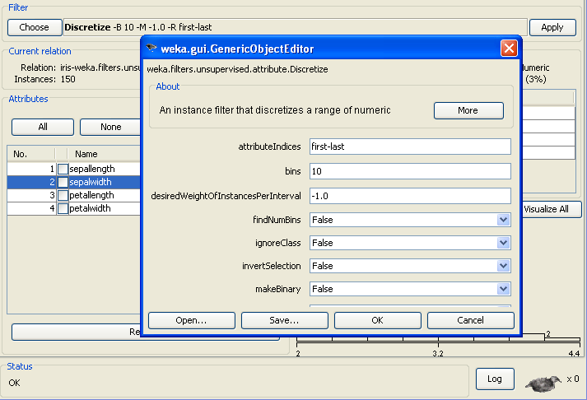
Adjust parameters’s value as you need
Click button Apply to run selected task

Slide 10
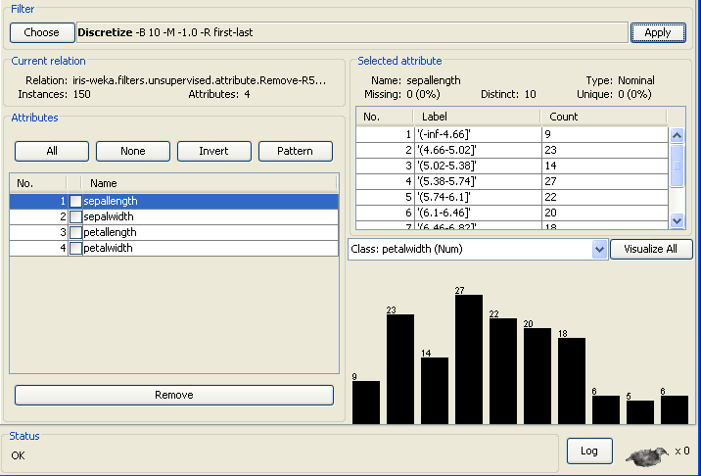
For example : results after discretized

Slide 11
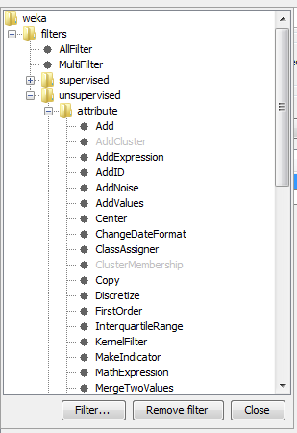
In Preprocess tab, you can select tasks such as
Discretize
Normalize
Remove feature
Add feature
Attribute selection
PCI
……

Slide 12
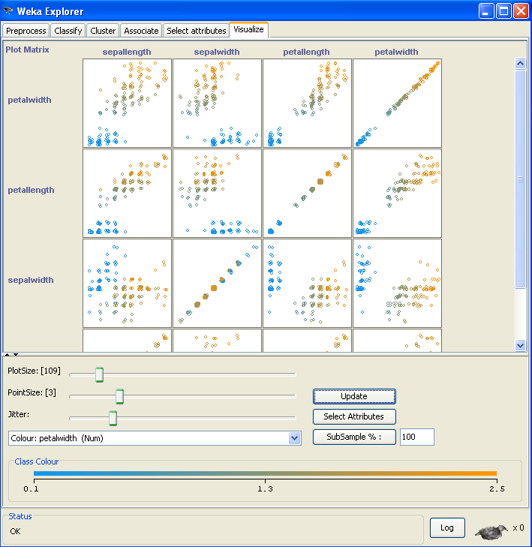

Tab Visualize : Graph between each pair of features

Slide 13
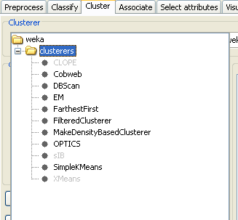
Tab Cluster : Clustering dataset with choosen method

Slide 14
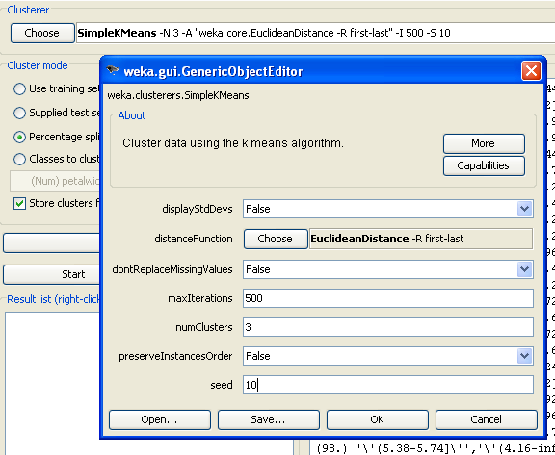
After choosing any task, click here to customize parameters

Slide 15
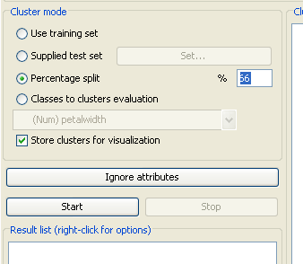
Choose testing dataset
At last, click button Start : execute task

Slide 16
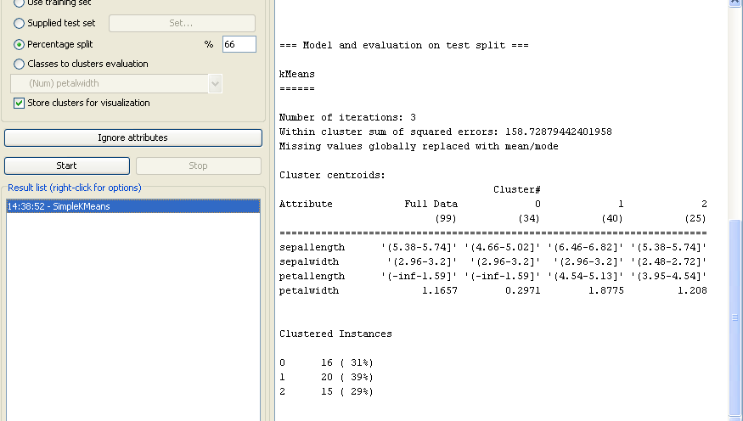
Result after running

Slide 17
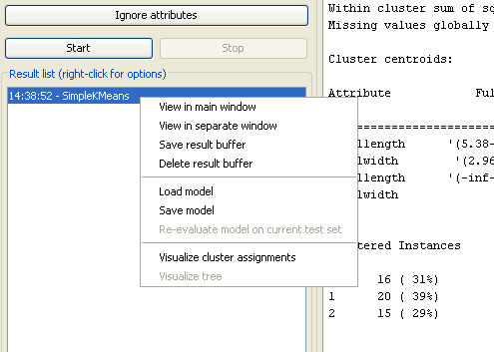
Right click here : submenu appears
For example, you click at Visualize cluster assigments

Slide 18
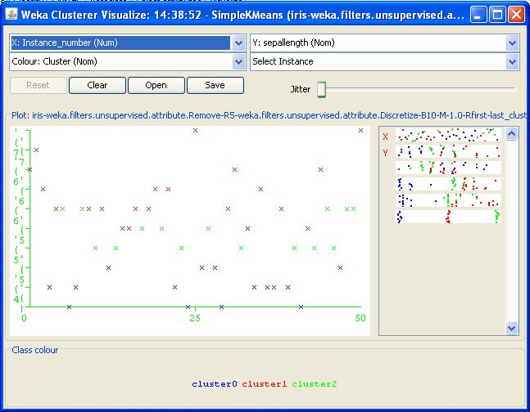
You can see results in graph format

Slide 19
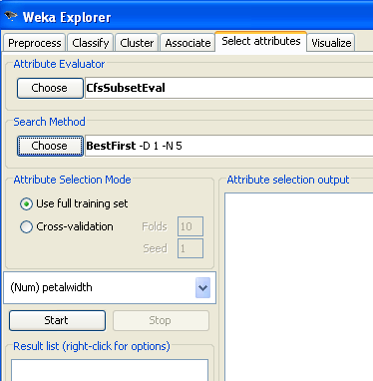
Tab Select attributes : Feature selection and extraction

Slide 20
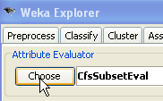
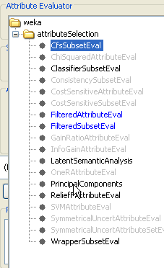
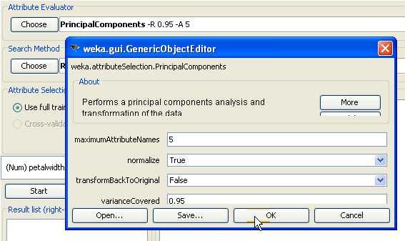
Feature extraction :

Slide 21
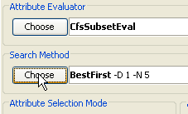
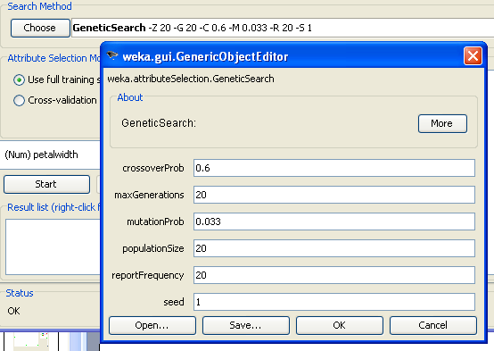
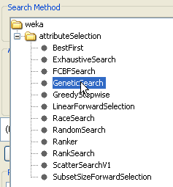
Feature selection :

Slide 22
You have to learn how to use WEKA for other tasks :classifying , RBF ,….
You can email to me if get troubles
      nguyendt22@vcu.edu
Good luck

